Slide 1
Directions:
Read the word in the Christmas tree. Find the word on the right that means the OPPOSITE (antonym). Drag and drop the red rectangle on the correct answer. The red rectangle is at the bottom. This is worth 10 points.

Slide 2
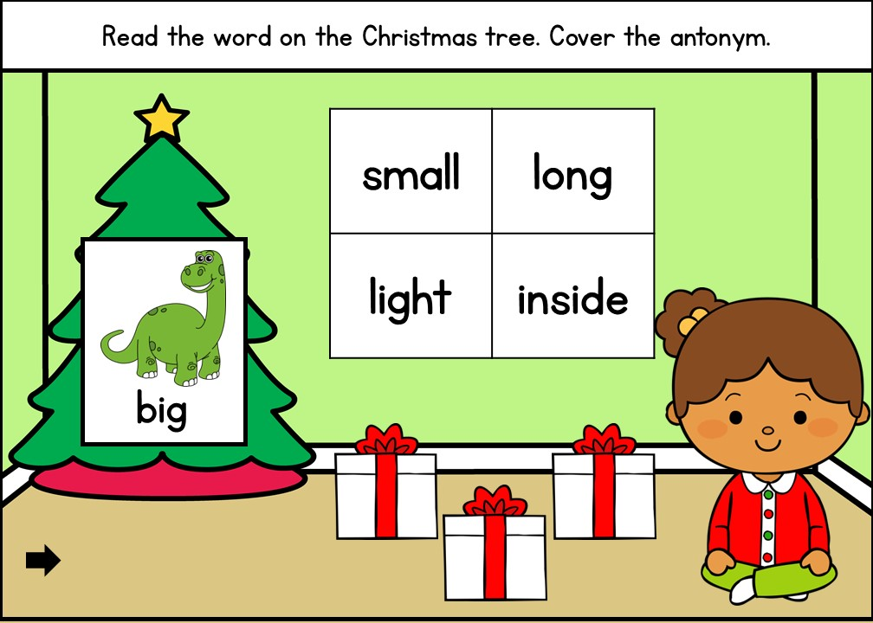

Slide 3
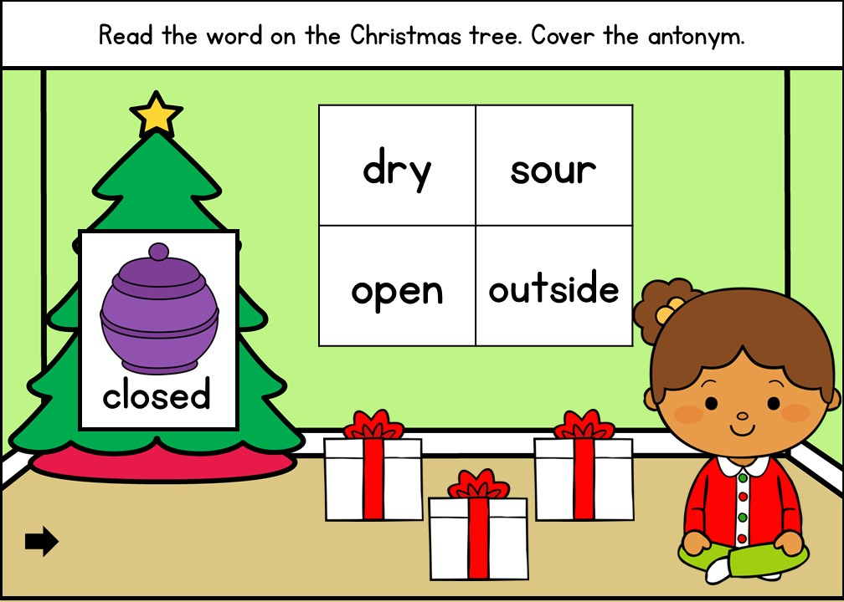

Slide 4
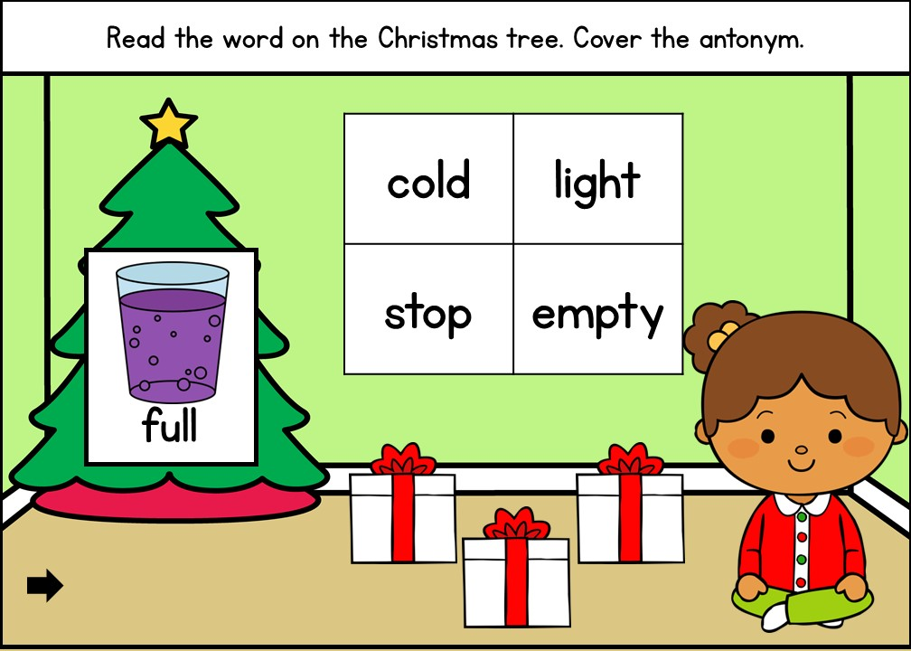

Slide 5
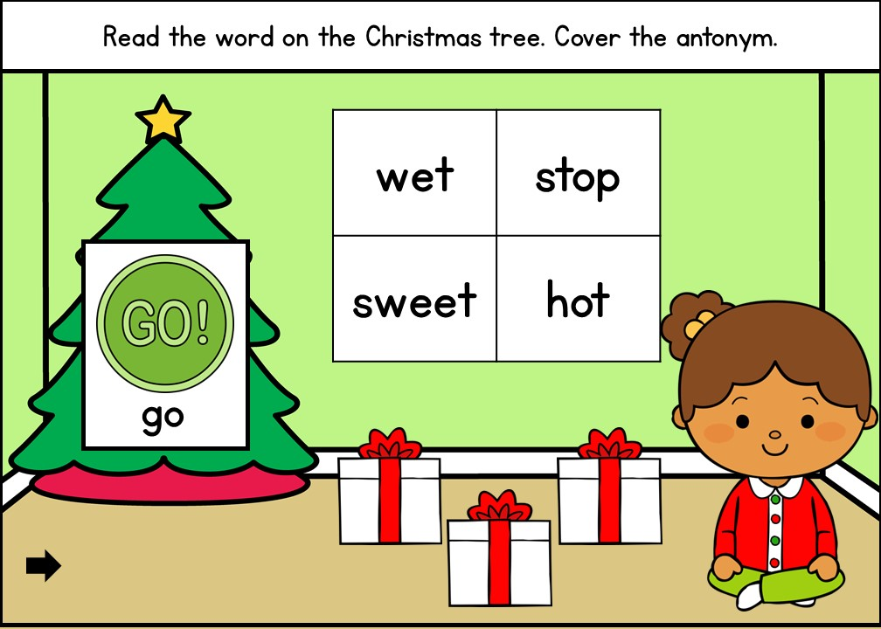

Slide 6
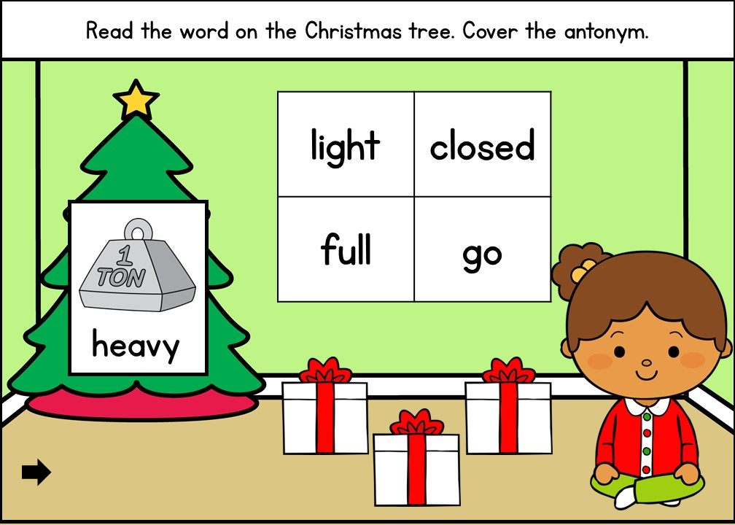

Slide 7
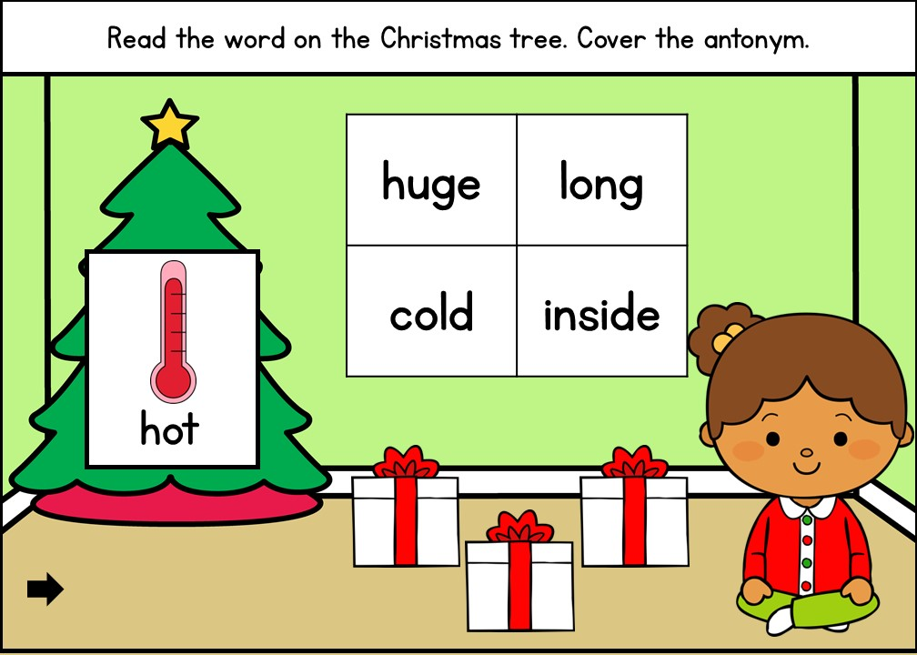

Slide 8
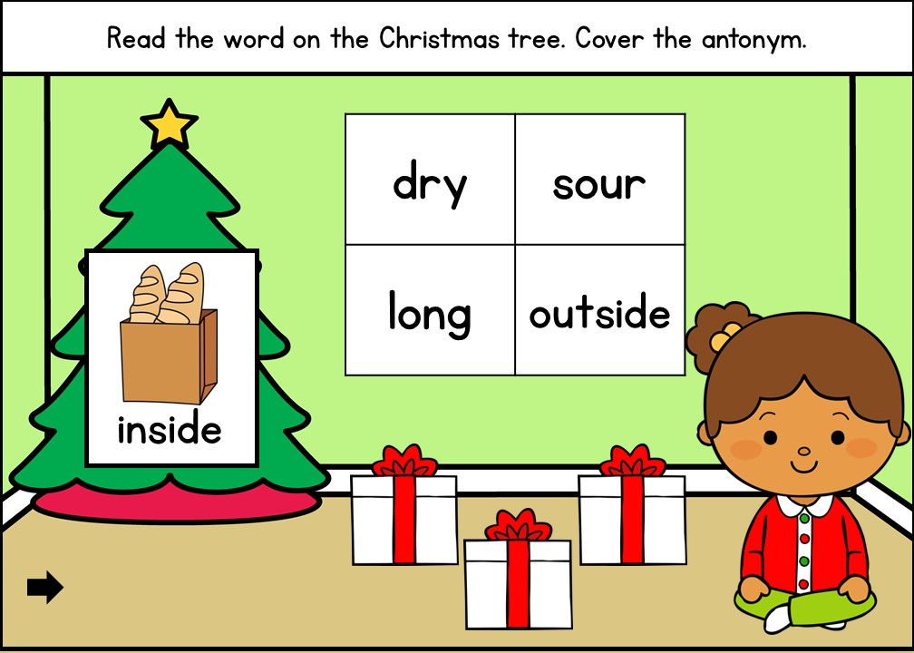

Slide 9
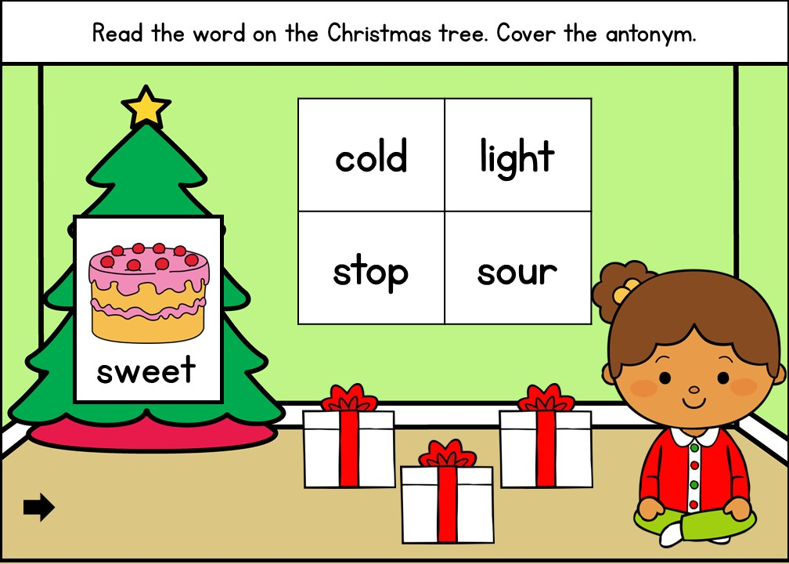

Slide 10
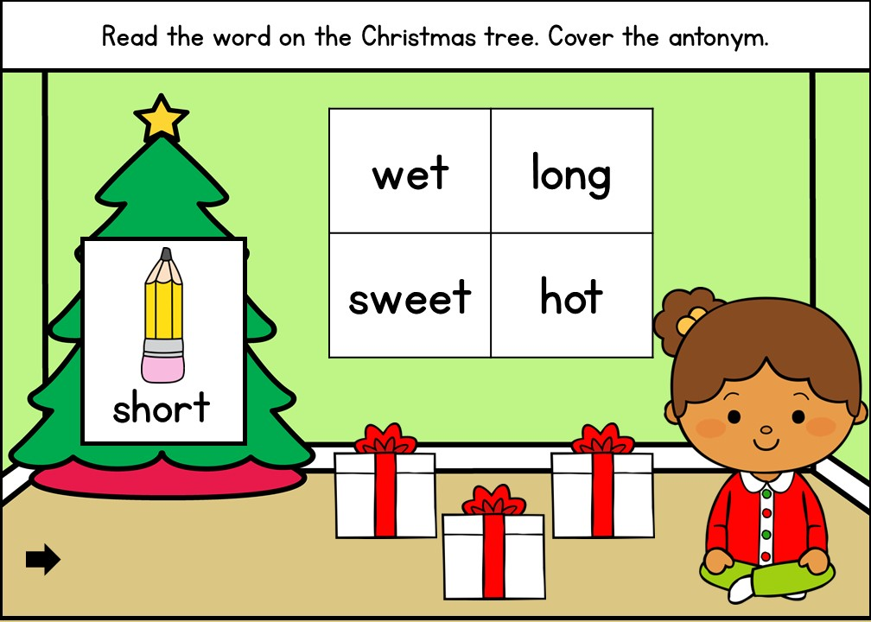

Slide 11


